Slide 1
Fair Housing Presentation
to
Nevada Commission on Minority Affairs
Monday, September 19, 2022
9AM

Slide 2
Silver State Fair Housing Council
Private nonprofit agency funded by grants from HUD and local jurisdictions
Mission: Ensure equal housing opportunity for all residents of Nevada
Offices in Las Vegas and Reno
Programs:
Fair housing enforcement – assistance in filing housing discrimination complaints, housing discrimination testing
Education and outreach – provide housing consumers and providers with resources to understand and comply with fair housing laws
Assessing barriers to equal housing opportunity
We are here to be a resource for you and your constituents!
Notes:
Welcome all

Slide 3
Fair housing laws
Under the federal Fair Housing Act, it is illegal to discriminate in the provision of housing and housing-related services based on:
Race
Color
National origin
Religion
Sex
 Gender  Harassment  Sexual orientation  Gender identity
Familial status
Disability
In addition, Nevada State Law provides protections for:
Ancestry
Sexual orientation
Gender identity or expression

Slide 4
All entities that control and/or have an effect on housing or housing choice are covered by FHA
Property owners
Property management companies, agents, onsite workers
Service contractors
Real estate agents, brokers
Lending institutions, title companies, escrow companies
Appraisers
Homeowner Associations (HOA)
Cooperatives
Developers/contractors
Public Housing Authorities
Agencies that receive funds to provide housing

Slide 5
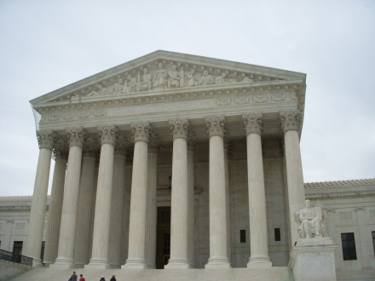
Remedies
Administrative complaints to HUD or to Nevada Equal Rights Commission
Up to one year from last alleged incident of discrimination
Judicial Process – federal or state court
Up to two years from the last alleged incident of discrimination

Slide 6
Silver State Fair Housing Council
Silver State Fair Housing Council (SSFHC) is a non-profit agency advocating for equal access to housing in Nevada since 1989. SSFHC has office locations in Reno and Las Vegas to better address inquiries about housing discrimination for consumers, housing providers, and local jurisdictions. SSFHC also provides services in rural communities through personal interactions, meeting utilizing remote technologies, and community partnerships. SSFHC strives to break down barriers to equal housing opportunity and build opportunities for community members to relate to each other as neighbors by addressing the needs of all members of the community. SSFHC provides education and outreach about fair housing rights; processes discrimination complaints, investigations, and referrals; and assesses barriers to fair housing in Nevada. SSFHC works to guarantee the right of all people to freely choose where they want and can afford to live.
1-888-585-8634 toll free ● Relay Nevada 711
FairHousing@ssfhc.org ● www.ssfhc.org
Southern Nevada 2920 South Jones Blvd, Suite 230 Las Vegas, NV 89146 P.O. Box 30936, Las Vegas, NV 89173 702-749-3288 702-749-3299 fax | Northern Nevada 110 West Arroyo Street, Suite A Reno, NV 89509 P.O. Box 3935, Reno, NV 89505 775-324-0990 / 775-324-0438 775-324-7507 fax

